Slide 1
Face Mask Detection Project (FMDP)
Mark Stockwell & Wesley Ng

Slide 2
Executive Summary
Coronavirus disease, also known as COVID-19 is an infectious disease that can contribute to mild, moderate, and sometimes extreme respiratory problems. It is airborne contagious and can spread through virus particles that are spread through the air when someone coughs, sneezes, or even talk. Because it is very infectious, CDC guidelines has issued out recommendations for everyone to wear masks to prevent the spread of these viruses. Retail stores, restaurants, and public buildings were advised to enforce mandatory face mask wearing in the building. Backlash, however, has arose over the past year that opposed wearing masks. People not wearing masks would be able to go into public places without getting detected and potentially cause infections to increase. This project was created to help promote face mask detection so that enforcement can be maintained.

Slide 3
Business Use Case
The Face Mask Detection Project (FMDP) will serve as an software solution enforcer for determining whether people are currently wearing face masks. It will use machine learning to learn how people look with face masks from static images and then be able to predict off of new images that are fed into the system whether or not an individual is wearing a face mask. This solution will help detect anyone coming into locations incognito with no face masks.

Slide 4
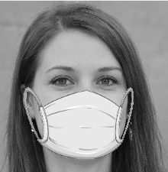
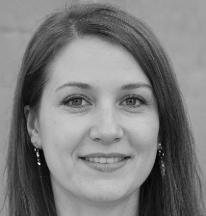
Data Procurement
We will be extracting a dataset that contains thousands of images of people wearing masks and not wearing masks from Kaggle. Kaggle is normally a platform that holds competitions where people will take the same dataset and compete against each other for a particular goal set. We will be taking these images and training a model to understand what people look like when they do and don’t wear a mask. The data will be collected either through Kaggle API or Kaggle CLI (Command Line Interface). The data set is 630 MB big with other 10,000 images with people who wear masks and 10,000 images with people who don’t wear masks. Here is an example of the images we will be utilizing for machine learning.

Slide 5
Data Profiling
The data that we collect has the following characteristics:
224 X 224 Pixel Length and Width
Dataset Size (628 MB) containing 20,000 images
Grayscale images
Front Face Only
Face Mask Overlays on images that contain face masks
Size of Each Photo: Around 32 KB
Paired images of same person for both with mask and without mask
Each person labeled with Unique Identification: Seed-XXXX (Range 0000 - 9999)
With-Mask-Seed0001
Seed0001

Slide 6
Data Storage
Our main data storage will consist of Amazon S3 bucket storage. Because it is easily accessible and scalable it would be easy to transfer JPEG images to S3. NoSQL databases would have also been a good choice for image storage. However, we believed that having data stored in S3 would make integration work in Amazon SageMaker more seamless. In the case that JPEG images are not allowable on S3, we will convert images into bit representations and store text files into S3 for model training.

Slide 7
Modeling Approaches
We will be using Tensorflow Serving to do image classification and training on the images with and without masks. Tensorflow Serving is a machine learning deployment service that streamlines model development workflows. We will be creating a neural network that will train off of these images. Some potential approaches to modeling will be ResNet and DenseNet. We will be utilizing a VGG16 model and do transfer learning to build a model that is learned off of the data set that we procure. This model will then be able to be deployed to Tensorflow Serving for REST API connection predictions.

Slide 8
Technology Stack

Slide 9

Kaggle Dataset
Kaggle serves as our source of our data sets for this project. It supports a variety of data set publication formats for easy access and transformations. Some of these formats consist of CSV's, JSON, SQLite, PNG/JPEG Images, and much more. We chose Kaggle as our primary data source because they have a nice clean data set that does not require much transformation and can be used straight out of the box. The images that we were provided to help train our models would consist of pairwise images that have both a mask and nonmask overlay. Because our dataset of images will be extracted from Kaggle and datasets on Kaggle are not dynamically changing, we will be using batch processing to transfer the data into S3 for consumption by SageMaker. These images will utilize S3 as the primary storage. In the case that we receive new updated images or want to include other images for training, we will simply just batch process the images for S3. All mask data images will not change when put into the datalake storage.

Slide 10
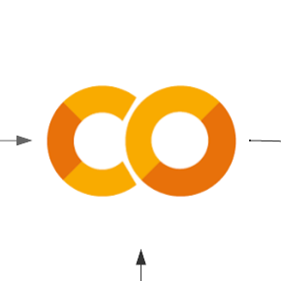
Google Colab
Google Colaboratory allows anyone to write and execute arbitrary python code in the browser. It comes with many different libraries and software development kits that assist with machine learning and data mining. Additionally, it provides free computing resources. Although some usages are limited, Google Colab helps with synchronizing our workflow to ensure that development is always up to date. We chose google colab because it has the environment that has most of the libraries preinstalled. All we would have to do as developers is ensure that our code matches our cloud services in terms of authorization and access.

Slide 11

Amazon S3
Amazon Simple Storage Service (Amazon S3) is an object storage service that offers scalable storage, data availability, security, and performance. We use Amazon S3 to help build data lakes to help store the images we extract from Kaggle. S3 is an object service that stores data as objects within buckets. Images that we extract that contain masks will be separated from the images without masks in different buckets. Boto3 (Amazon’s Software Development Kit) helps make it easy to transfer images locally to the cloud. From there these images can be used for training models either locally or via Amazon SageMaker

Slide 12
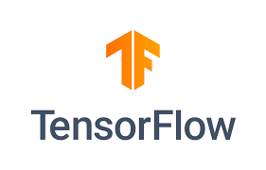
Tensorflow Serving
Tensorflow Serving is a serving system that is highly scalable and flexible when it comes to deploying machine learning models into production environments for inference. Developers will train Tensorflow models that follow the Tensorflow model standard. These models will then be deployed on Tensorflow Serving where REST API request can be sent with JSON formatted data as input for a JSON response with the output from the model that was generated.

Slide 13
Architecture Diagram

Slide 14
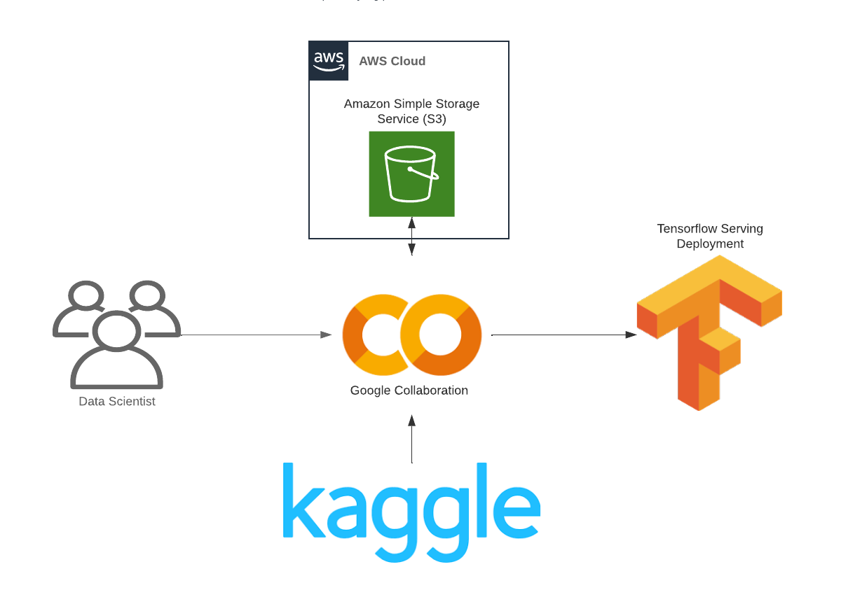
Solution Architecture
Kaggle dataset will be loaded to S3 via python Jupyter Notebook.
Train and test datasets will be randomly split and stored in separate S3 folders.
SageMaker will read directly from S3.

Slide 15
Data Processing

Slide 16
Data Pipelines - Download from Kaggle
Python code executed on Colaboratory infrastructure will download and unzip the Kaggle dataset.
!pip3 install opendatasets
import datetime
import opendatasets as od
print("starting download",datetime.datetime.now())
od.download("https://www.kaggle.com/pranavsingaraju/facemask-detection-dataset-20000-images")

Slide 17
Data Pipelines - Upload to S3
from re import sub
import boto3
import os
def upload_files(path,bucket):
session = boto3.Session()
s3 = session.resource('s3')
bucket = s3.Bucket(bucket)
filecount = 0
for subdir, dirs, files in os.walk(path):
print('uploading dir',subdir)
for file in files:
full_path = os.path.join(subdir, file)
with open(full_path, 'rb') as data:
bucket.put_object(Key=full_path[len(path)+1:], Body=data)
filecount +=1
print(' file count:',filecount)
The AWS boto3 library uploads the images to S3 buckets in separate folders for labeling.

Slide 18
Data Pipelines - Split into Train/Test sets
# Randomly move files
train_size = 100
test_size = 20
train_range = random.sample(range(10000),train_size)
test_range = random.sample(range(10000),test_size)
for n in train_range:
file_name = "seed" + str(n).zfill(4) + ".png"
f_with = "new_with_mask/with-mask-default-mask-" + file_name
f_without = "new_without_mask/" + file_name
copy_s3_files(f_without, f'/train/{file_name}')
copy_s3_files(f_with, f'/train/{file_name}')
for n in test_range:
file_name = "seed" + str(n).zfill(4) + ".png"
f_with = "new_with_mask/with-mask-default-mask-" + file_name
f_without = "new_without_mask/" + file_name
copy_s3_files(f_without, f'/test/{file_name}')
copy_s3_files(f_with, f'/test/{file_name}')
The AWS boto3 library randomly assigns labeled data to train/test folders based on size parameters.

Slide 19
Creating Datasets on Images
train_ds = tf.keras.utils.image_dataset_from_directory(
"./mask_data/train/", class_names=['mask', 'no_mask'], label_mode='int', color_mode='rgb', batch_size=1, image_size=(256,
256), shuffle=True, seed=None, validation_split=None, subset=None,
interpolation='bilinear', follow_links=False,
crop_to_aspect_ratio=False
)
In order to prepare for model training, we will need to convert our images into datasets that are capable of being interpreted by our models. This will be applied for the test and training datasets

Slide 20
Model Training

Slide 21
Transfer learning on VGG16 Model
from tensorflow.keras import layers, models
flatten_layer = layers.Flatten()
dense_layer_1 = layers.Dense(50, activation='relu')
prediction_layer = layers.Dense(1, activation='sigmoid')
model = models.Sequential([
base_model,
flatten_layer,
dense_layer_1,
prediction_layer
])
We can take our transformed images and do transfer learning with an existing model with labels that we created for masks and no masks

Slide 22
Repository Structure

Slide 23
Directory Structure
root.
├───data
│ ├───test
│ │ ├───mask
│ │ └───no_mask
│ ├───train
│ │ ├───no_mask
│ │ └───mask
│ ├───new_with_mask
│ └───new_without_mask
├───scripts
├───model
│ ├───1
│ └───2
├───output
│ └───20220227_1309
└───input
└───20220227_1309
Directory is structured to support multiple models and multiple batch transformations. It can be replicated locally for development purposes via the Local Mode of the SageMaker python SDK.

Slide 24
Data Directories
Directories store full set of master images and subdirectories for training and test.
Master image directories:
new_with_mask
new_without_mask
Train and test directories populated with random samples for development needs.
Directory names act as labels.
Filenames globally unique.
root.
├───data
│ ├───test
│ │ ├───mask
│ │ └───no_mask
│ ├───train
│ │ ├───no_mask
│ │ └───mask
│ ├───new_with_mask
│ └───new_without_mask

Slide 25
Scripts Directory
The scripts directory contains python notebooks and scripts to process data and maintain the model.
ProcessKaggleDataset.ipynb - python jupyter notebook to download base image archive and unzip into the master image folder.
Resample.py - takes a random sample of full image dataset for training/test purposes.
MaskDetectionModel.ipynb - python jupyter notebook to build and train the model
DeploySagemakerModel.ipynb - deploy the model to AWS (Initial Approach Exploratory Work)
root.
├───scripts
│ ProcessKaggleDataset.ipynb
│ resample.py
│ MaskDetectionModel.ipynb
│ DeploySagemakerModel.ipynb

Slide 26
Input/Output/Model Directories
The scripts directory contains python notebooks and scripts to process data and maintain the model.
Model directory has subdirectories for each version of the model. Typically a compressed tar file.
Output directory stores labeled images and output artifacts from the model (logs, parameters, accuracy)
Input directory stores a set of files for processing.
Both the input and an output files have subdirectories indicating the UTC date/time the process was initiated. The output directory will match the input directory used.
root.
├───model
│ ├───1
│ └───2
├───output
│ └───20220227_1309
└───input
└───20220227_1309

Slide 27
Deployment

Slide 28
Root Directory
The root directory is the main entry point to the program.
Requirements.txt - list of package dependencies.
FaceMaskDetectionWithTensorServing.ipynb - primary interface, allows uploading zip file of images for classification.
Readme.md - markdown file with file names/descriptions and usage.
Root.
│ requirements.txt
│ FaceMaskDetectionWithTensorServing.ipynb
│ readme.md

Slide 29
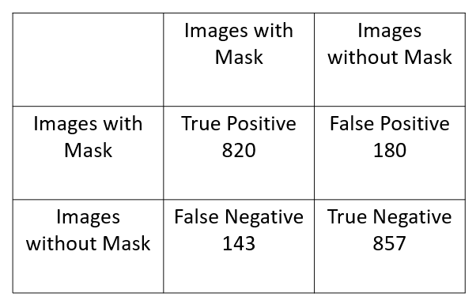
Model Results
We did validation on a portion of our dataset that consisted of 2000 images composing of 1000 images with masks and 1000 images without masks.
Our model was able to achieve an overall accuracy of 87% when it came to predicting close up images of people’s faces with and without masks.

Slide 30
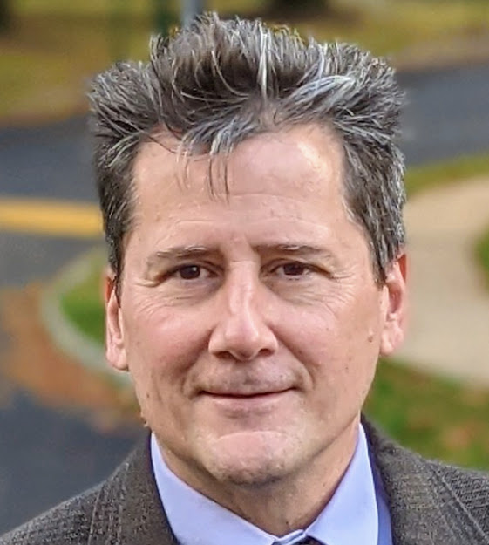
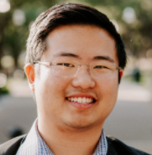
About Us
Mark Stockwell
Systems Analyst @ Google (7 Years)
Master Data Management Consultant @ Myers-Holum (6 Years)
Prior work experience in Business Intelligence/Data Warehousing
Wesley Ng
Data Engineer @ Capital One (1 Month Current Role)
Software Engineer @ Lockheed Martin (3.5 Years)
Graduated from Texas A&M 2018 with BS in Computer Science

